Slide 1
MOTIONS OF THE EARTH
https://www.youtube.com/watch?v=EXasopxAFoM
https://www.youtube.com/watch?v=4v0pNmMxIlk
https://www.youtube.com/watch?v=UlCLX27NqMg
https://www.youtube.com/watch?v=m__qvGxW12I

Slide 2
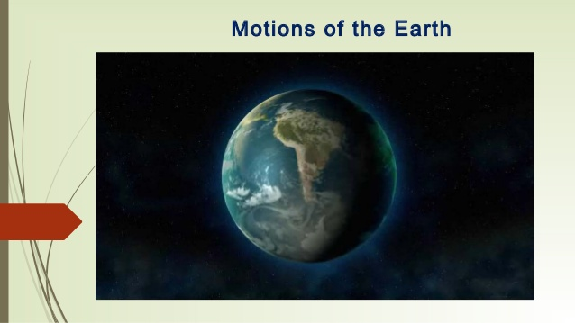

Slide 3
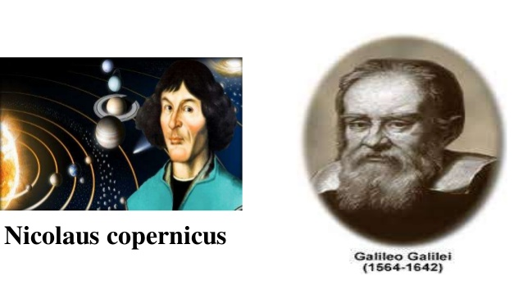
WHO BROUGHT IT TO OUR NOTICE?

Slide 4
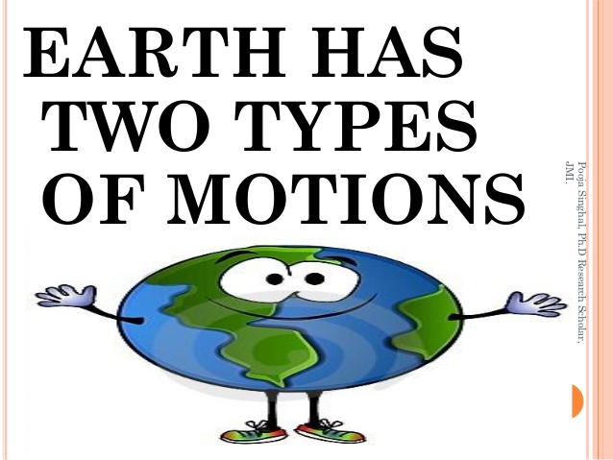
HOW MANY MOTIONS?

Slide 5
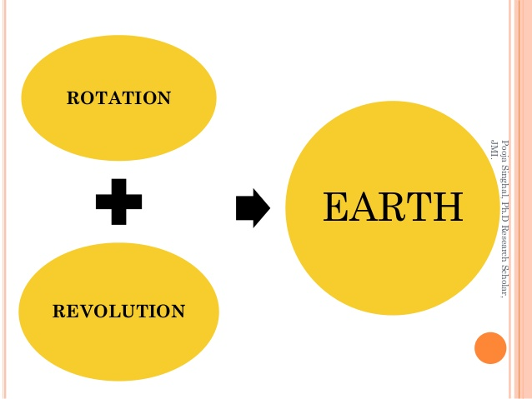
THE TWO MOTIONS OF THE EARTH

Slide 6
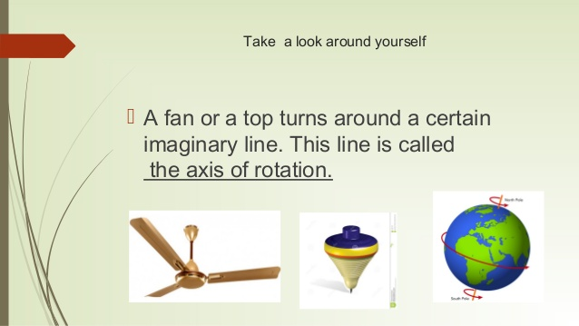
ROTATION

Slide 7
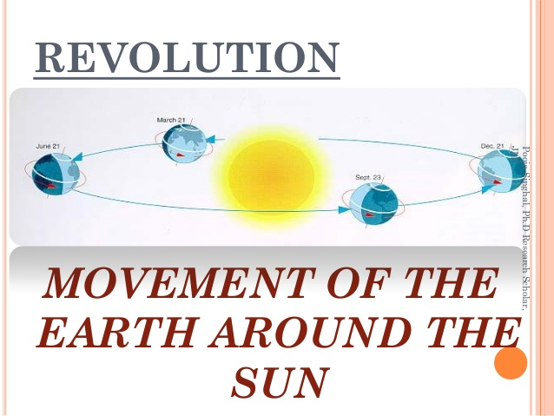
REVOLUTION

Slide 8
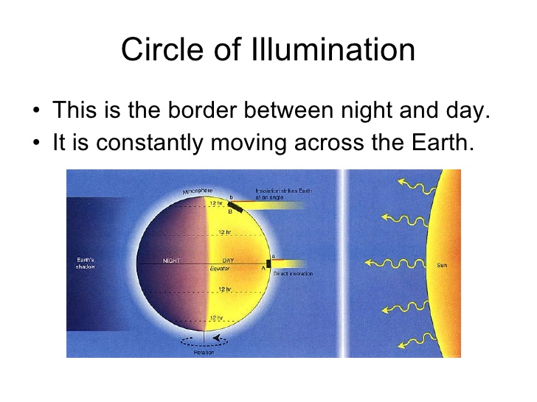
RESULT OF ROTATION

Slide 9
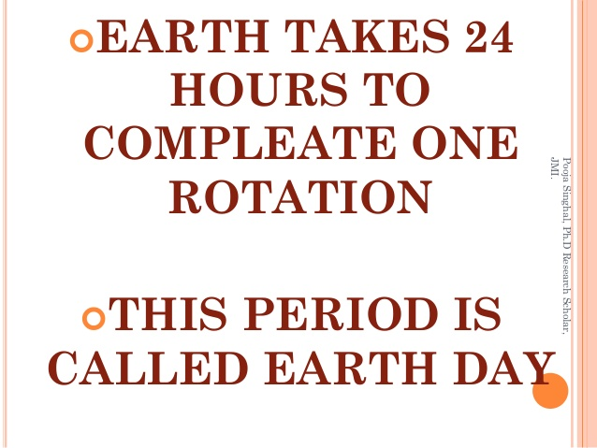
WHAT IS EARTH DAY?

Slide 10
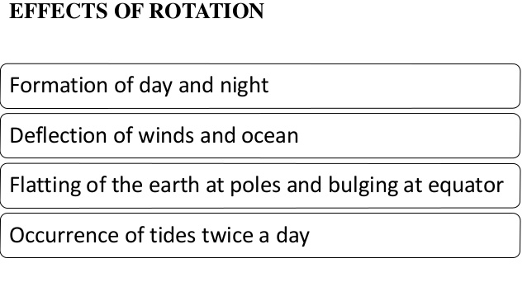
OTHER EFFECTS OF ROTATION

Slide 11
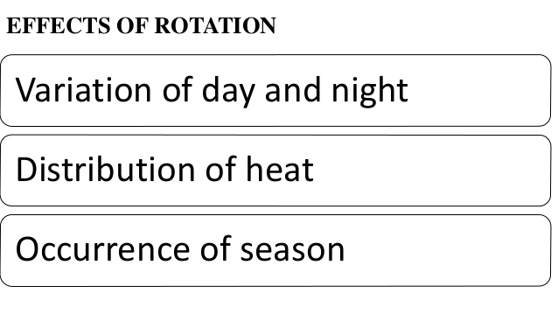

Slide 12
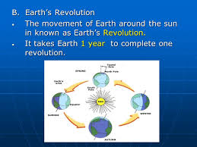
SECOND MOTION- REVOLUTION

Slide 13
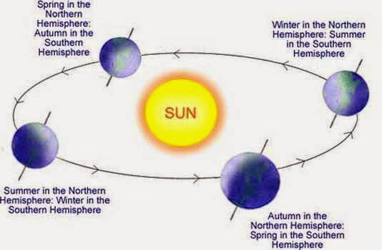
EFFECT OF REVOLUTION

Slide 14
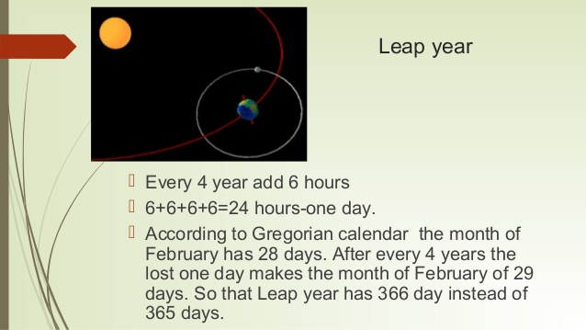
ANOTHER EFFECTOF REVOLUTION

Slide 15
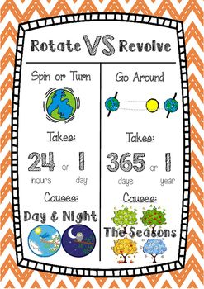
ROTATION VS REVOLUTION

Slide 16
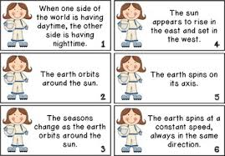
LET’S SUM UP

